Slide 1
PROJECT PROPOSAL
PREDICTING THE GDP MOVEMENT TRENDS
Team members:
Rohit Khokle
Madhava Peddisetti
Pranatha Rao

Slide 2
PROBLEM STATEMENT
By looking at historical data, how we can accurately predict GDP movement trends of top performing countries (USA, China, Germany, UK, France, India) based on access, spending, and years of education, healthcare, agriculture
Use classification algorithm performs best in distinguishing the up and down trends in economic growth and try to invest accordingly in our newly formed country – Republic of Data-stan.

Slide 3
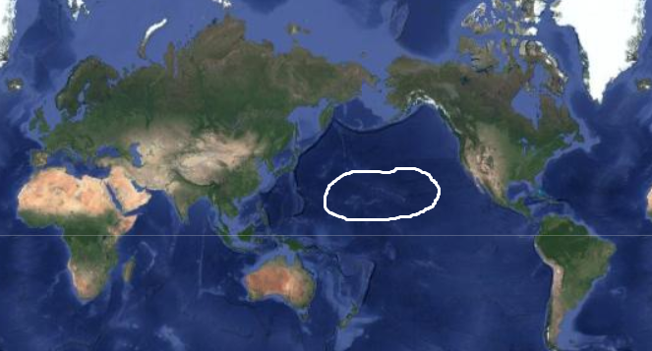
Preface
Republic of Data-stan is an island country on middle of Pacific ocean.
Its east coast neighbors are USA, Canada and west coast neighbors are Russia, Japan and Philippines and some coast of China

Slide 4
MAJOR SECTORS CONTRIBUTING TO GDP
We focus on increasing our Nation’s income in the following ways:
1) Investment in Education: We analyze the top countries in Education and how it affects their GDP
2) Investment in Quality Healthcare: Identify countries with good quality healthcare, how it affects the quality of life and find the correlation with services/economy.
3) Investment in Agriculture: Identify suitable crops with similar geographic locations and then find how it contributes to the GDP

Slide 5
THANK YOU

